Slide 1



Center Surround Research Update
Ian Cone
Shouval Lab
10/26/20

Slide 2
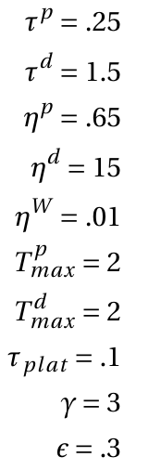
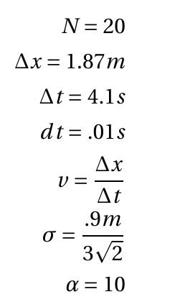
Parameters
Time constant of LTP trace
Number of input neurons
Time constant of LTD trace
Length of track
Activation rate of LTP trace
Time taken to traverse track
Activation rate of LTD trace
Time step
Learning rate
Velocity
Maximum, LTP trace
Maximum, LTD trace
STD of CA3 place fields
Time constant of instructive signal
Weight multiplier
Magnitude of instructive signal
Magnitude of initial weights

Slide 3
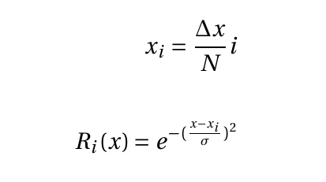

Input from CA3
CA3 inputs are modeled as Gaussians evenly distributed across track
Weights are initialized as a Gaussian centered around synapse W_center

Slide 4
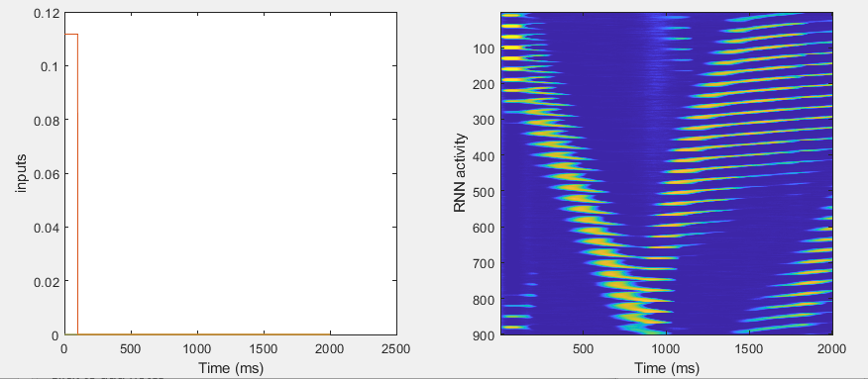
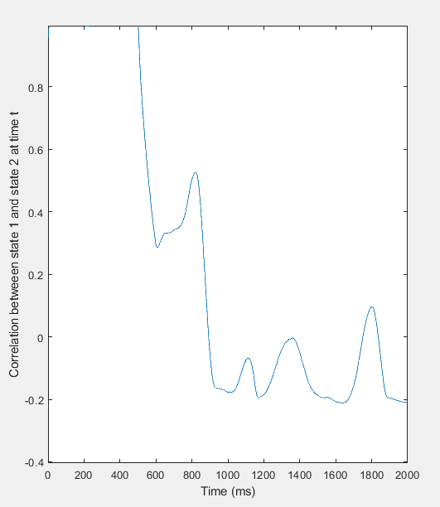
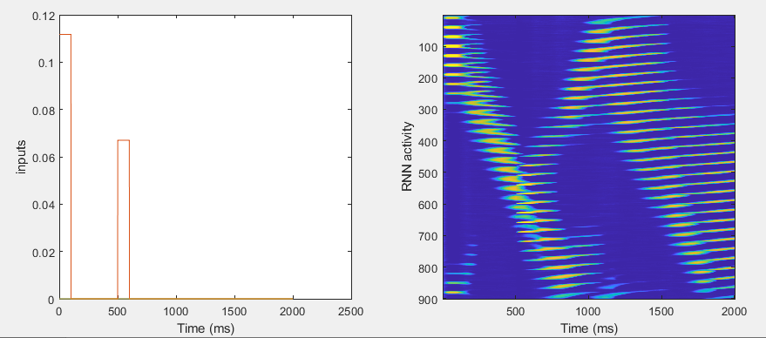
A
A-B

Slide 5
A
A-B

Slide 6
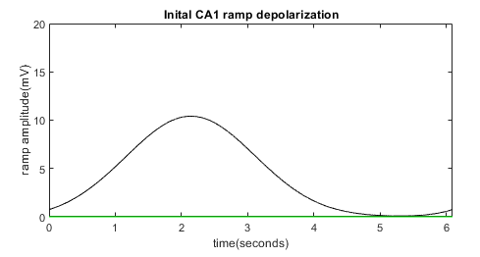

PostSynaptic Voltage

Slide 7
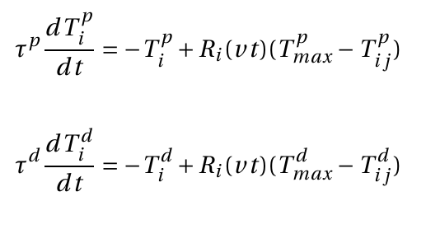
Presynaptic, weight-dependent traces
LTP and LTD associated traces are activated by presynaptic activity and decay in its absence

Slide 8
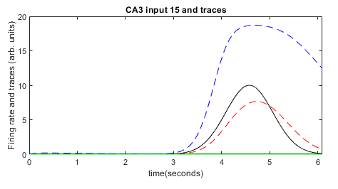
Presynaptic, weight-dependent traces

Slide 9
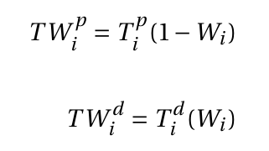

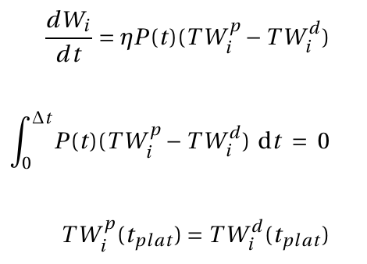
Instructive Signal and Weight updates
Weight modified versions TW favor LTD as weights are large and LTP as weights are small
“Instructive signal” from plateau potential acts as reward
Weights are updated in the presence of the instructive signal as LTP-LTD (both weight modified)

Slide 10
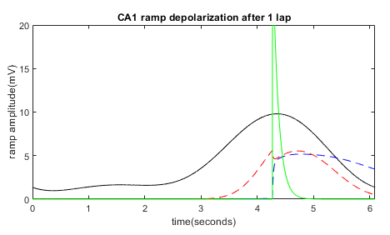
Instructive Signal and Weight updates

Slide 11
Fixed Points
(if P(t) is a delta)

Slide 12
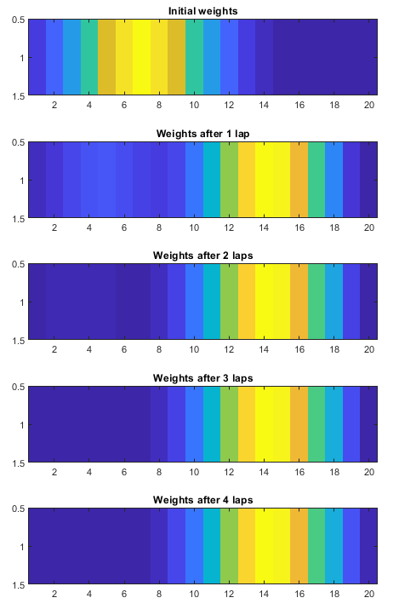
Fixed Points

Slide 13
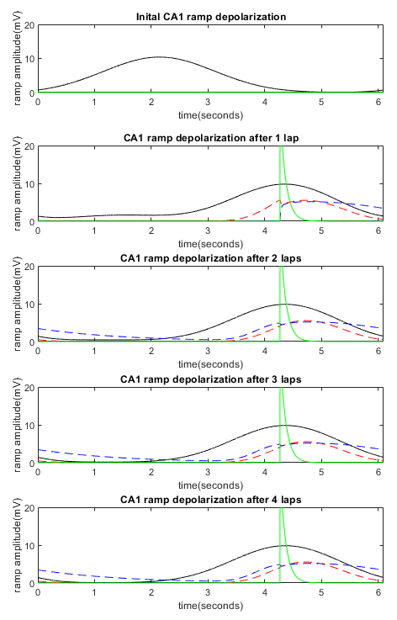
Fixed Points

Slide 14
Fixed Points
Fixed point of each synapse is independent (since no postsynaptic component of learning)
Learning does not change presynaptic firing, so shape of traces does not change (only magnitude)

Slide 15
Fixed Points
CA3 input and traces

Slide 16
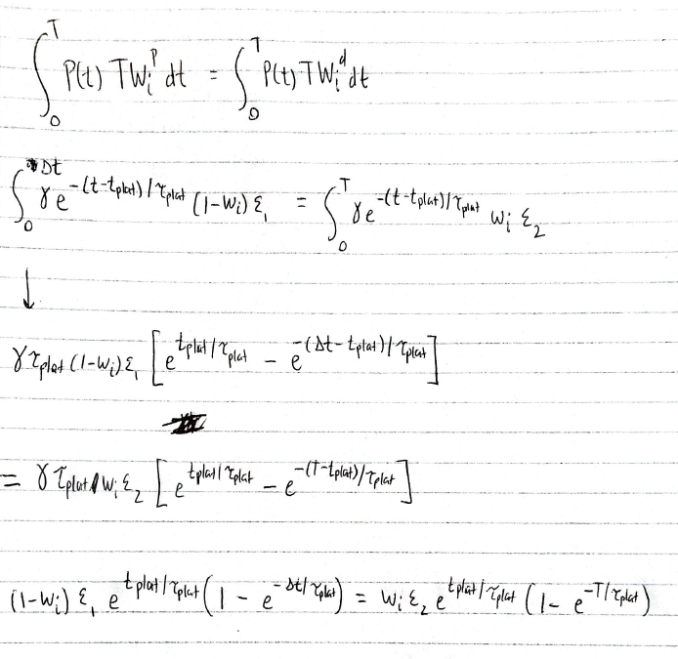
Fixed Points

Slide 17
Fixed Points
CA3 input and traces

